Slide 1

Data-Intensive Distributed Computing
CS 431/631 451/651 (Winter 2019)
Part 7: Mutable State (2/2)
March 19, 2019
Adam Roegiest
Kira Systems
These slides are available at http://roegiest.com/bigdata-2019w/
This work is licensed under a Creative Commons Attribution-Noncommercial-Share Alike 3.0 United States See http://creativecommons.org/licenses/by-nc-sa/3.0/us/ for details

Slide 2
The Fundamental Problem
We want to keep track of mutable state in a scalable manner
Assumptions:
State organized in terms of logical records
State unlikely to fit on single machine, must be distributed
MapReduce won’t do!

Slide 3
Motivating Scenarios
Money shouldn’t be created or destroyed:
Alice transfers $100 to Bob and $50 to Carol
The total amount of money after the transfer should be the same
Phantom shopping cart:
Bob removes an item from his shopping cart…
Item still remains in the shopping cart
Bob refreshes the page a couple of times… item finally gone

Slide 4
Motivating Scenarios
People you don’t want seeing your pictures:
Alice removes mom from list of people who can view photos
Alice posts embarrassing pictures from Spring Break
Can mom see Alice’s photo?
Why am I still getting messages?
Bob unsubscribes from mailing list and receives confirmation
Message sent to mailing list right after unsubscribe
Does Bob receive the message?

Slide 5
Three Core Ideas
Why do these scenarios happen?
Partitioning (sharding)
To increase scalability and to decrease latency
Need distributed transactions!
Replication
To increase robustness (availability) and to increase throughput
Need replica coherence protocol!
Caching
To reduce latency
Need cache coherence protocol!

Slide 6
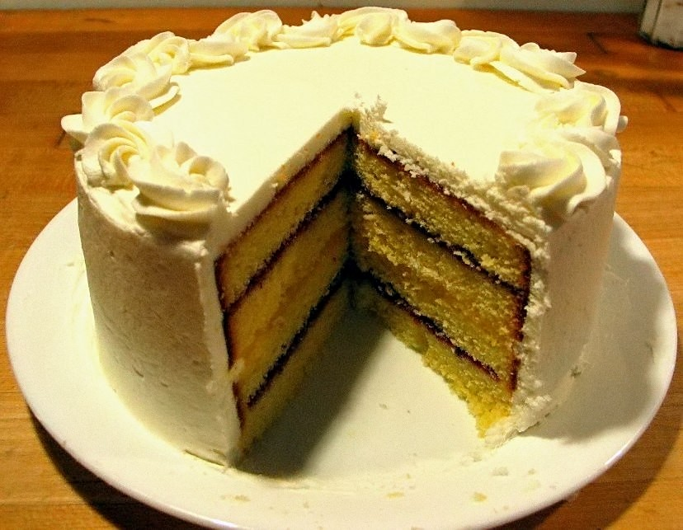
Source: Wikipedia (Cake)

Slide 7
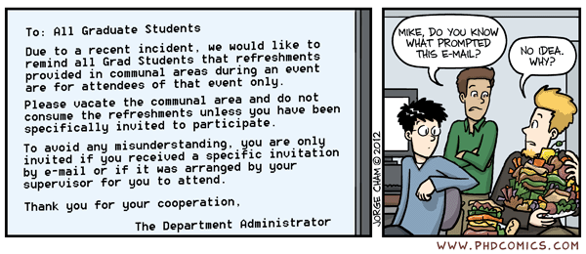
Morale of the story: there’s no free lunch!
(Everything is a tradeoff)
Source: www.phdcomics.com/comics/archive.php?comicid=1475

Slide 8
Three Core Ideas
Why do these scenarios happen?
Partitioning (sharding)
To increase scalability and to decrease latency
Need distributed transactions!
Replication
To increase robustness (availability) and to increase throughput
Need replica coherence protocol!
Caching
To reduce latency
Need cache coherence protocol!

Slide 9

Relational Databases
… to the rescue!
Source: images.wikia.com/batman/images/b/b1/Bat_Signal.jpg

Slide 10
How do RDBMSes do it?
Transactions on a single machine: (relatively) easy!
Partition tables to keep transactions on a single machine
Example: partition by user
What about transactions that require multiple machines?
Example: transactions involving multiple users
Solution: Two-Phase Commit

Slide 11
2PC: Sketch
Okay everyone, PREPARE!
YES
Good. COMMIT!
ACK!
YES
DONE!
ACK!
Coordinator
YES
ACK!
subordinates

Slide 12
2PC: Sketch
Okay everyone, PREPARE!
YES
ABORT!
YES
Coordinator
NO
subordinates

Slide 13
2PC: Sketch
Okay everyone, PREPARE!
YES
Good. COMMIT!
ACK!
YES
ACK!
Coordinator
YES
subordinates

Slide 14
2PC: Assumptions and Limitations
Assumptions:
Persistent storage and write-ahead log at every node
WAL is never permanently lost
Limitations:
It’s blocking and slow
What if the coordinator dies?

Slide 15
Three Core Ideas
Why do these scenarios happen?
Partitioning (sharding)
To increase scalability and to decrease latency
Need distributed transactions!
Replication
To increase robustness (availability) and to increase throughput
Need replica coherence protocol!
Caching
To reduce latency
Need cache coherence protocol!

Slide 16
Replication possibilities
Okay, but if the master fails?
Update sent to a master
Replication is synchronous
Replication is asynchronous
Combination of both
Update sent to an arbitrary replica
Replication is synchronous(?)
Replication is asynchronous
Combination of both

Slide 17
Distributed Consensus
More general problem: addresses replication and partitioning
Hi everyone, let’s change the value of x.
Hi everyone, let’s execute a transaction t.
…
Paxos
Time

Slide 18
Replication possibilities
Okay, but if the master fails?
Update sent to a master
Replication is synchronous
Replication is asynchronous
Combination of both
Update sent to an arbitrary replica
Replication is synchronous(?)
Replication is asynchronous
Combination of both
Guaranteed consistency with a consensus protocol
A buggy mess
“Eventual Consistency”

Slide 19
CAP “Theorem”
(Brewer, 2000)
Consistency
Availability
Partition tolerance
… pick two

Slide 20
CAP Tradeoffs
CA = consistency + availability
E.g., parallel databases that use 2PC
AP = availability + tolerance to partitions
E.g., DNS, web caching

Slide 21
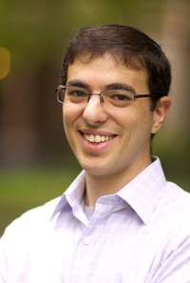
Is this helpful?
CAP not really even a “theorem” because vague definitions
More precise formulation came a few years later
Wait a sec, that doesn’t sound right!
Source: Abadi (2012) Consistency Tradeoffs in Modern Distributed Database System Design. IEEE Computer, 45(2):37-42

Slide 22
Abadi Says…
CP makes no sense!
CAP says, in the presence of P, choose A or C
But you’d want to make this tradeoff even when there is no P
Fundamental tradeoff is between consistency and latency
Not available = (very) long latency

Slide 23
Move over, CAP
PACELC (“pass-elk”)
PAC
If there’s a partition, do we choose A or C?
ELC
Otherwise, do we choose Latency or Consistency?

Slide 24
At the end of the day…
Guaranteed consistency with a consensus protocol
A buggy mess
“Eventual Consistency”
Sounds reasonable in theory…
What about in practice?

Slide 25
Morale of the story: there’s no free lunch!
(Everything is a tradeoff)
Source: www.phdcomics.com/comics/archive.php?comicid=1475

Slide 26

h = 2^{n} – 1
h = 0
Solution: Replication
N = 3, replicate +1, –1
Covered!
Covered!
Machine fails: What happens?

Slide 27
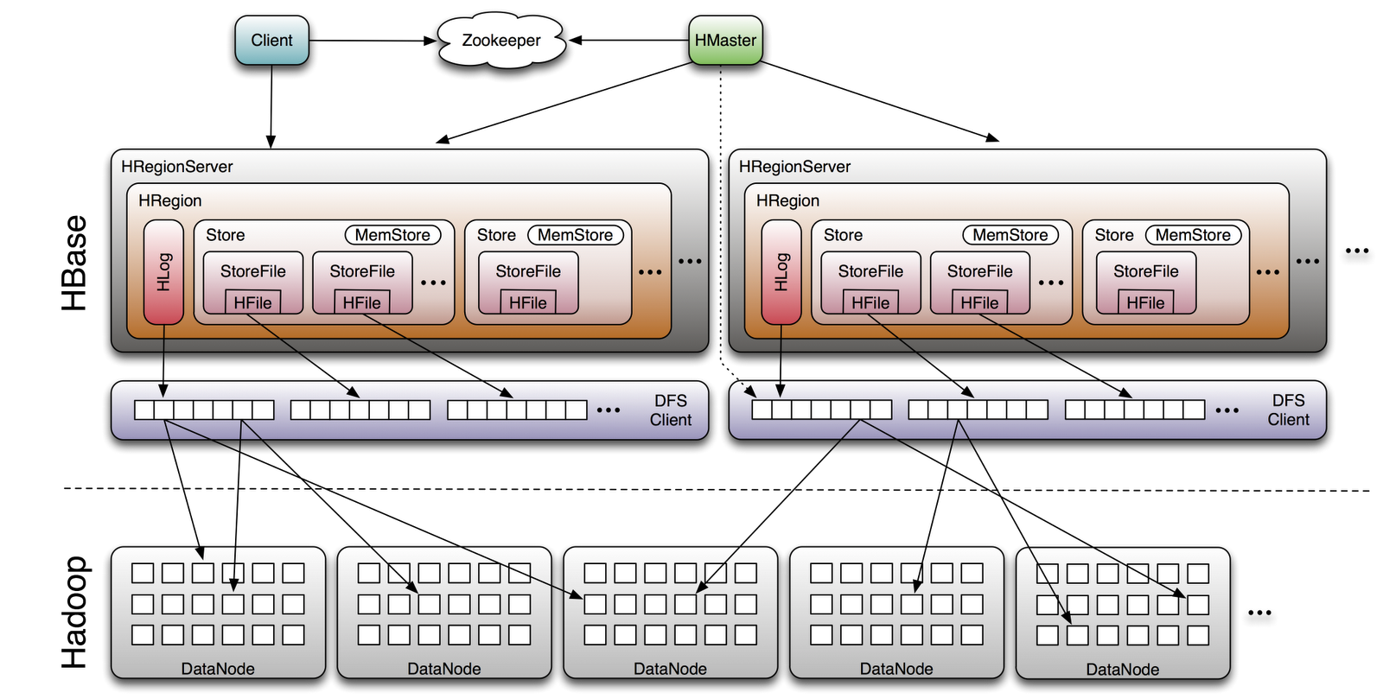
HBase
Image Source: http://www.larsgeorge.com/2009/10/hbase-architecture-101-storage.html

Slide 28
Three Core Ideas
Why do these scenarios happen?
Partitioning (sharding)
To increase scalability and to decrease latency
Need distributed transactions!
Replication
To increase robustness (availability) and to increase throughput
Need replica coherence protocol!
Caching
To reduce latency
Need cache coherence protocol!

Slide 29
Facebook Architecture
memcached
MySQL
Read path:
Look in memcached
Look in MySQL
Populate in memcached
Write path:
Write in MySQL
Remove in memcached
Subsequent read:
Look in MySQL
Populate in memcached
Source: www.facebook.com/note.php?note_id=23844338919

Slide 30
Facebook Architecture: Multi-DC
memcached
memcached
MySQL
MySQL
Replication lag
California
Virginia
User updates first name from “Jason” to “Monkey”.
Write “Monkey” in master DB in CA, delete memcached entry in CA and VA.
Someone goes to profile in Virginia, read VA replica DB, get “Jason”.
Update VA memcache with first name as “Jason”.
Replication catches up. “Jason” stuck in memcached until another write!
Source: www.facebook.com/note.php?note_id=23844338919

Slide 31
Facebook Architecture: Multi-DC
memcached
memcached
MySQL
MySQL
Replication
= stream of SQL statements
California
Virginia
Solution: Piggyback on replication stream, tweak SQL
REPLACE INTO profile (`first_name`) VALUES ('Monkey’) WHERE `user_id`='jsobel' MEMCACHE_DIRTY 'jsobel:first_name'
Source: www.facebook.com/note.php?note_id=23844338919

Slide 32
Three Core Ideas
Why do these scenarios happen?
Partitioning (sharding)
To increase scalability and to decrease latency
Need distributed transactions!
Replication
To increase robustness (availability) and to increase throughput
Need replica coherence protocol!
Caching
To reduce latency
Need cache coherence protocol!

Slide 33
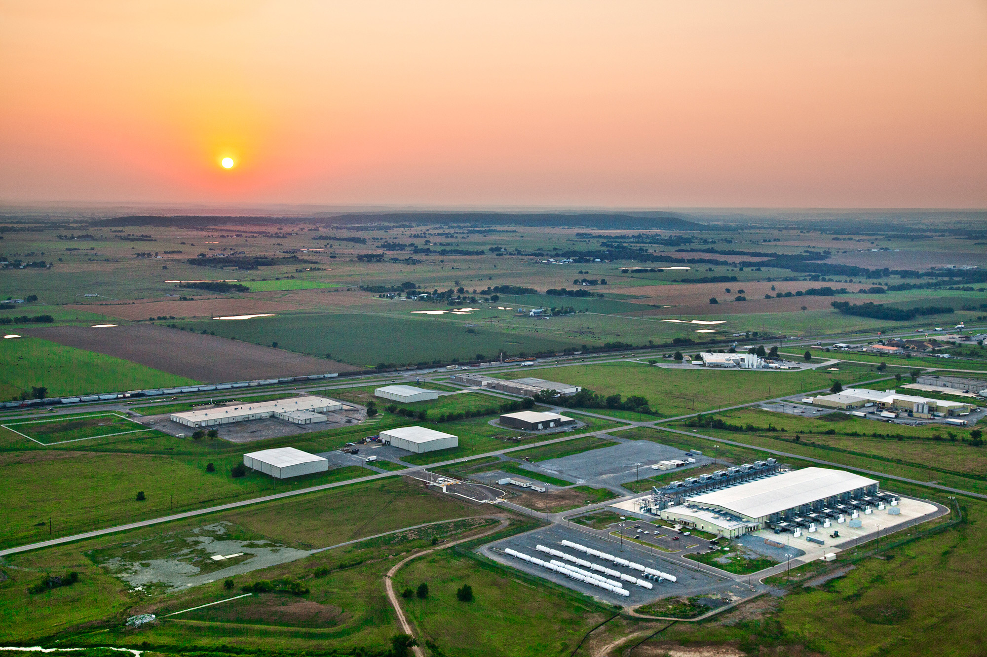
Now imagine multiple datacenters…
What’s different?
Source: Google

Slide 34
tl;dr -
Single row transactions
Easy to implement, obvious limitations
Implement a global consensus protocol for every transaction
Guarantee consistency, but slow
Eventual consistency
Who knows?

Slide 35
tl;dr -
Single row transactions
Easy to implement, obvious limitations
Implement a global consensus protocol for every transaction
Guarantee consistency, but slow
Eventual consistency
Who knows?
Can we cheat a bit?

Slide 36
tl;dr -
Per partition
✗
Implement a global consensus protocol for every transaction
✗
Guarantee consistency, but slow
And fast!
Entity groups
Groups of entities that share affinity
Example: user + user’s photos + user’s posts etc.

Slide 37
Google’s Megastore
Source: Baker et al., CIDR 2011

Slide 38
But what if that’s not enough?

Slide 39
Source: Llyod, 2012

Slide 40
Source: Llyod, 2012

Slide 41
Source: Llyod, 2012

Slide 42
Google’s Spanner
Features:
Full ACID translations across multiple datacenters, across continents!
External consistency (= linearizability): system preserves happens-before relationship among transactions
How?
Given write transactions A and B, if A happens-before B, then timestamp(A) < timestamp(B)
Source: Llyod, 2012

Slide 43
Source: Llyod, 2012

Slide 44
Source: Llyod, 2012

Slide 45
Source: Llyod, 2012

Slide 46

What’s the catch?
Source: The Matrix

Slide 47
Three Core Ideas
Partitioning (sharding)
To increase scalability and to decrease latency
Need distributed transactions!
Replication
To increase robustness (availability) and to increase throughput
Need replica coherence protocol!
Caching
To reduce latency
Need cache coherence protocol!

Slide 48
Source: Wikipedia (Cake)

Slide 49
Morale of the story: there’s no free lunch!
(Everything is a tradeoff)
Source: www.phdcomics.com/comics/archive.php?comicid=1475

